Slide 1

Preference Learning with Gaussian Process to learn weights of aesthetically pleasing motion
Semester Project: Yuwen Chen
Supervisor: Christoph Gebhardt
1

Slide 2
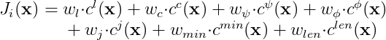
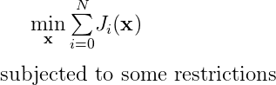
Motivation
Quadrotor is widely used in film industry
Trajectory generation via MPC controller
Tuning cost weights in MPC controller is time-consuming
MPC scheme
2

Slide 3


Our Goal
The pipeline optimizes cost weights in MPC via user’s preference over two videos
The pipeline could optimize multiple cost weights at the same time
Which is preferred?
3

Slide 4
Outline
Methodology
Gaussian Process
Thurstone-Mosteller Likelihood Model
Maximum A Posteriori Estimation
Hyperparameter Optimization
Prediction
Expected Improvement
Experiment
Experimental Design
Results
Summary
4

Slide 5
Methodology
5

Slide 6
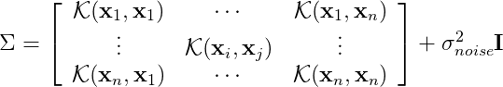
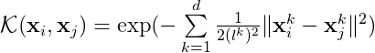
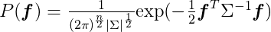
Gaussian Process
Build prior model
Latent function:
Kernel function
Prior
6

Slide 7
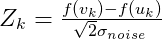
Thurstone-Mosteller Likelihood model
Model for binary comparison
Preference set:
Value function:
Likelihood model:
7

Slide 8
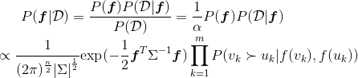
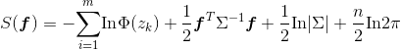
Maximum A Posteriori Estimation
Point Estimation
Posterior
Latent value optimization
8

Slide 9
Hyperparameter Optimization
Point estimation
Laplace approximation
Optimization
9

Slide 10
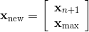
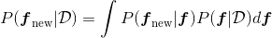
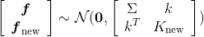
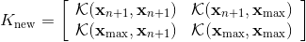
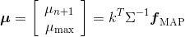
Prediction
Selecting two groups of weights for the next comparison
Weights selection
Predictive model
Approximated gaussian predictive model
10

Slide 11
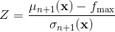
Expected Improvement (EI)
Finding the next group of weights based on EI value
Improvement function
Expected Imrpovement
Selecting next group of weights
11

Slide 12
Experiment
12

Slide 13
Experimental Design
Fixed time length motion
1d jerk weight learning
2d jerk-contour weights learning
Aesthetically pleasing motion
2d jerk-contour weights learning
13

Slide 14
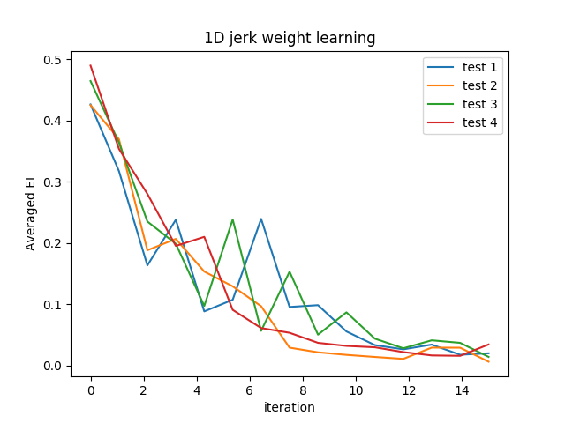
Results
Fixed time length motion
1D jerk weight learning (132 groups, 15 iterations)
Error measurement
Convergence Guarantee
Test number | Time error
1 | 0.012(1st)
2 | 0.012(1st)
3 | 0.092(6th)
4 | 0.046(3rd)
14

Slide 15
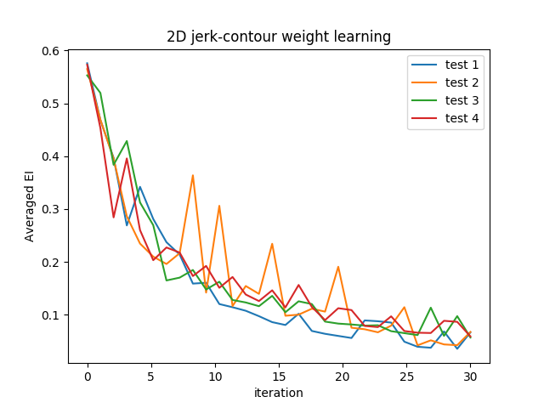
Results
Fixed time length motion
2D jerk-contour weights learning (739 groups, 30 iterations)
Error measurement
Convergence Guarantee
Test number | Time error
1 | 1.05 (34th)
2 | 0.10 (4th)
3 | 0.08 (2nd)
4 | 0.27 (8th)
15

Slide 16


Results
Aesthetically pleasing motion
2D jerk-contour weights learning (20 iterations)
Initialization
After 20 iterations
16

Slide 17
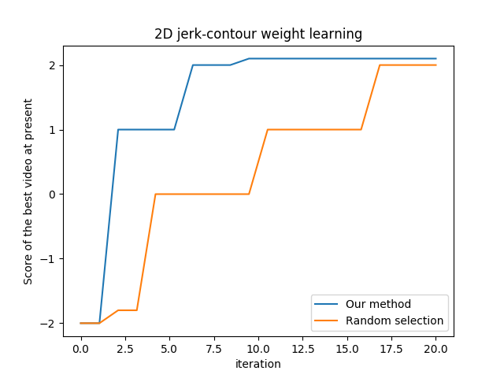
Results
Aesthetically pleasing motion
2D jerk-contour weights learning (739 groups, 20 iterations)
Score of parameters via our method vs. random selection
17

Slide 18
Summary
Preference learning with Gaussian Process could efficiently select good parameters from parameter space in low dimensional space
Limitation
Not beneficial if good cost weights are not sparse in parameter space
Increasingly computationally expensive with increase of iterations
Future Work
Find a efficient way to do MAP estimation and hyperparameter optimization iteratively
Delve into kernel selection in Gaussian Process and prior setup for hyperparameters
18

Slide 19
Q&A
19

